Slide 1
EXCEPTION HANDLING

Slide 2
Exception Handling
• Exception: “An abnormal condition that arises in a code sequence at run time”. An exception is a run-time error. Exception handling allows us to manage run-time errors in an orderly fashion.
An exception is a problem that arises during the execution of a program.
• A C++ exception is a response to an exceptional circumstance that arises while a program is running, such as an attempt to divide by zero. • Exceptions provide a way to transfer control from one part of a program to another.
• C++ exception handling is built upon three keywords: try, catch, and throw.

Slide 3
INTRODUCTION
#include <iostream> using namespace std;
int main() { double a, b, c;
// Request two numbers from the user cout << "Please provide two numbers\n"; cout << "First Number: "; cin >> a; cout << "Second Number: "; cin >> b;
// Multiply the numbers and display the result c = a * b;
cout << "\n" << a << " * " << b << " = " << c << "\n\n"; return 0; }

Slide 4
INTRODUCTION
When it comes up, the user is asked to simply type two numbers; the program would use them to perform a multiplication and display the result
Imagine that a user, decides to type the name of a country or somebody’s telephone number as one of the requested values.
Since a program such as this one is not prepared to multiply two strings or one number to a string it would not know what to do.
The only alternative the compiler would have is to send the problem to the operating system, hoping that the OS would know what to do.
Whenever the compiler is handed a task, it would try to perform the assignment. If it can’t perform the assignment, for any reason it is not prepared for, it would throw an error.
As a programmer, if you can anticipate the type of error that could occur in your program, you can catch the error yourself and deal with it by telling the compiler what to do when this type of error occurs.

Slide 5
INTRODUCTION
Using exception handling, our program can automatically invoke an error-handling routine when an error occurs. C++ exception handling is built upon three keywords: try, catch, and throw
try identifies a code block where exception can occur
throw causes an exception to be raised (thrown)
catch identifies a code block where the exception will be handled (caught)
General Syntax
try {
… throw an exception …
}
catch the exception

Slide 6
Exception Handling Fundamentals ..try
Error prone program statements that we may want to monitor for generation of exceptions are contained in a try block.
Syntax:
try {
// try block
}
When an exception is thrown, the remaining code in the try block is skipped, just as in the case of the return statement in a function, and every auto object created after the try block is entered, is destroyed automatically
The thrown object is caught by the catch block where the execution continues
Then, the execution continues with the next statement after the catch block

Slide 7
Exception Handling Fundamentals …throw
If an exception (i.e., an error) occurs within the try block, then that exception is thrown using throw.
Syntax:
throw exception;
If an exception is to be caught, then throw must be executed either from within a try block or from any function called from within the try block (directly or indirectly).

Slide 8
Exception Handling Fundamentals …catch
• The thrown exception is caught, using catch block and processed.
• Syntax:
catch (type argument) {
// catch block
}
Note :
You must supply at least one catch block for a try block ;Otherwise compiler error
Catch blocks must immediately follow the try block without any program code between them. – Otherwise, compiler error
Multiple catch blocks allowed
Throwing an unhandled exception causes the standard library function terminate() to be invoked. By default, terminate() calls abort() to stop your program.

Slide 9
Exception Handling
try {
int d = 0; int a = 30 / d;
}
catch(int e ) {
}
printf("Division by zero.");
Complete Syntax
try {
………..
throw exception;
}
catch(Argument)
{
// Catch the exception
}

Slide 10
EXCEPTION HANDLING
void main() {
int a, b, c;
float d;
cout << "Enter the value of a:";
cin>>a;
cout << "Enter the value of b:";
cin>>b;
cout << "Enter the value of c:";
cin>>c;
try {
if ((a - b) != 0) {
d = c / (a - b);
cout << "Result is:" << d;
} else {
throw (a - b);
}
} catch (int i) {
cout << "Answer is infinite because a-b is:" << i;
}
}

Slide 11
Example 2
#include <iostream>
using namespace std;
double division(int a, int b)
{ if( b == 0 )
{ throw "Division by zero condition!";
}
return (a/b);
}
int main () {
int x = 50;
int y = 0;
double z = 0;
try {
z = division(x, y);
cout << z << endl; }
catch (const char* msg)
{ cout << msg << endl; }
return 0; }

Slide 12
catch(…)
#include <iostream>
using namespace std;
int main()
{
int StudentAge;
cout << “Enter Student Age: ";
cin >> StudentAge;
try {
if(StudentAge < 0)
throw;
cout << "\nStudent Age: " << StudentAge << "\n\n";
}
catch(...)
{ }
cout << "\n";
return 0;
}
catch (...) is used to catch any unhandled exception

Slide 13
MULTIPLE CATCH BLOCKS
Syntax
try {
// protected code
}catch( ExceptionName e1 ) {
// catch block
}catch( ExceptionName e2 ) {
// catch block
}catch( ExceptionName eN ) {
// catch block
}

Slide 14
Multiple catch blocks
void test(int x)
{ try
{ if(x>0)
throw x;
else
throw 'x’;
}
catch(int x) {
cout<<"Catch a integer and that integer is:"<<x; }
catch(char x) {
cout<<"Catch a character and that character is:"<<x; } }
int main() {
cout<<"Testing multiple catches\n:";
test(10);
test(‘a’);
return 0; }

Slide 15
Rethrowing exceptions
Rethrowing exceptions
– Used when an exception handler cannot process an exception
– Rethrow exception with the statement: throw;
• No arguments
• If no exception thrown in first place, calls terminate
– Handler can always rethrow exception, even if it performed some processing
– Rethrown exception detected by next enclosing try block

Slide 16
Example
throw; // rethrow exception for further processing
}
cout<< “This should not print\n”;
}
int main() {
try {
throwException( );
cout<< “This should not print\n”;
} catch(exception e) { cout<<“Exception handled in main\n”;
}
cout<<“Prgm control continues after catch in main\n”; return 0;
}
#include <iostream> #include <exception>
using std::cout;
using std::endl;
using std::exception;
void throwException() {
// Throw an exception and immediately catch it.
try {
cout << "Function throwException\n";
throw exception();
// generate exception
} catch(exception e) {
cout<<“Exception handled in function throw Exception\n”;
}
Output:
Function throwException Exception handled in function throwException Exception handled in main Program control continues after catch in main

Slide 17
Exception Specifications
Exception specification (throw list) means listed exceptions canbe thrown by a function
Example: int g( double h ) throw ( a, b, c ) {
// function body
}
Function can throw only listed exceptions or derived types.
If other type thrown, function unexpected called throw() (i.e., no throw list) states that function will not throw any exceptions
In reality, function can still throw exceptions, but calls unexpected (more later)
If no throw list specified, function can throw any exception

Slide 18
EXCEPTION SPECIFICATION
int someFunction( double value ) throw ( int, double)
{
...
}
The above example means the someFunction() can throw only int and double type of exception…. If others are thrown it will generate unexpected error.
Other Examples
int Func(); // can throw anything\
int Gunc() throw(); // will throw nothing
int Hunc() throw(int , float); // can only throw int or double

Slide 19
Excption Specification example
#include <iostream>
using namespace std;
int throwint() throw (int)
{
throw 20;
return 1;
}
int throwchar( ) throw(char)
{
throw 'a’;
return 1;
}
int main() {
int n;
cout<<"enter either 1 or 2:";
cin>>n;
if(n==1) {
try {
throwint();
} catch(int a)
{ cout<<"integer type"<< a <<endl;
}
}
else if(n==2) {
try {
throwchar();
} catch(...)
{
cout<<"string type"<<<"invalid option"; }
}

Slide 20
Nested Exception
#include <iostream>
using namespace std;
int main(){
try {
try {
throw 20;
}
catch (int n) { cout << "Handle Partially ";
throw; //Re-throwing an exception }
}
catch (int n) {
cout << "Handle remaining "; } return 0;
}
Although a try-block followed by its catch-block can be nested inside another try-block
It is almost always better to place the nested try-block and its catch-block inside a function definition, then invoke the function in the outer try-block
An error thrown but not caught in the inner try-catch-blocks is thrown to the outer try-block where it might be caught

Slide 21
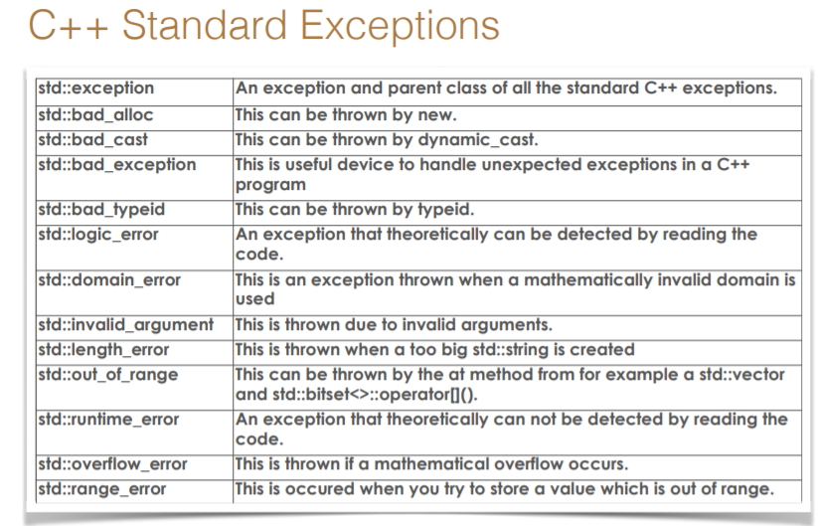

Slide 22
Define New Exceptions (Custom Exception)
• You can define your own exceptions by inheriting and overriding exception class functionality.
• It is called std::exception and is defined in the <exception> header.
This class has a virtual member function called what that returns a null-terminated character sequence (of type char *) and that can be overwritten in derived classes to contain some sort of description of the exception.

Slide 23
Custom Exception
// using standard exceptions
#include <iostream>
#include <exception>
using namespace std;
class myexception: public exception
{
const char* what() const throw()
{
return "My exception happened";
}
} myex;
int main () {
try
{ throw myex;
}
catch (exception& e)
{ cout << e.what() << '\n';
}
return 0;
}
We have placed a handler that catches exception objects by reference (notice the ampersand & after the type), therefore this catches also classes derived from exception, like our myex object of type myexception.

